Slide 1
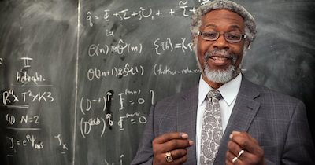
Sylvester James Gate
Notes:
#Name Sylvester James Gate #Textbook Knight, College Physics: A Strategic Approach, 2nd Edition, chapter 27, section 8 Knight, Physics for Scientists and Engineers: A Strategic Approach with Modern Physics, 3rd Edition, Chapter 39 #Contributors #Description Sylvester Gates is an American theoretical physicists for the Ford Foundation Professor at Brown University. Gates has received many accolades for his work including being a member of the National Academy of Sciences and receiving the National Medal of Science from President Obama. His work relates to supersymmetry, supergravity, and superstring theory, especially relating to the Adinkra Symbol to gain a better understand and graphically represent supersymmetric algebras. As a kid Gates gained an interest in the physics from books that his father brought home that inside was Schroedinger's equation. From that moment Gates became shocked by the mathematical representation of the world around him, ranging from the simple movement of a ball down a plane to a physics of the cosmos. #Sources McMaster, Joe. _View points on String Theory_. PBS, July 2003, [www.pbs.org/wgbh/nova/elegant/view- gates.html](http://www.pbs.org/wgbh/nova/elegant/view-gates.html). Gates , Sylvester James. “Bio Sylvester James Gates .” _Department of Physics_ , University of Maryland - College Park , [www.umdphysics.umd.edu/people/faculty/current/item/167-gatess.html#biography](http://www.umdphysics.umd.edu/people/faculty/current/item/167-gatess.html#biography). #Photo http://www.blackpast.org/files/Sylvester_James_Gates__2014.jpg

